Slide 1
Exploring the World of Programming Languages() {
< A Guided Tour to the Rich Tapestry of Programming Languages>
};
Programming Language

Slide 2
Names of Participants = () => {
KAMCHE YANN ARNAUD- FE21A208
TEGUE NONO MIKEL MODEIRO – FE21A321
NZEMETEJUH SYLVANUS – FE21A296
AMABO JOSHUA – FE21A135
CHAM NIBA – FE21A156
};
Programming Language

Slide 3
Outline;
0. Introduction
Definition of Programming Languages
Evolution of Programming Languages
Types of Programming Languages
Types of Programming Paradigms
Overview of Specific Programming Langugaes, their historical background, strength and weaknesses and areas of applications.
Trends in Programming Languages.
Case Studies (Real-World projects).
Conclusion
References
Programming Language

Slide 4
0. Introduction {
<
>
<Programming languages serve as the bedrock of software development, acting as the vital link between human creativity and machine execution.>
< What spoken languages is to communication between individuals, programming languages is to developers >
<Programming Languages plays vital role in shaping technologies>
};
Programming Language

Slide 5
1. What is a programming Language ?💻 {
< These are specialized sets of rules and syntax used to create instructions that computers can understand and execute. >
< They act as a bridge between human thought and machine action. >
< Convey complex ideas in a way that is comprehensible to both machines and other developers. >
< Translates written code into machine-executable code, processed by compiler or interpreter
};
Programming Language

Slide 6
2. Evolution of Programming Languages {
1957
➡ Birth of Fortran designed for engineering scientific computation
1950-1970’s
➡ Dominance of Assembly Languages and machine code, then marked a shift with the advent of high programming Languages like C and Pascal offering more abstraction.
1990’s
➡ Rise of Java with its platform independence and C++, introducing OOP concepts contributing to the development of diverse applications
Programming Language

Slide 7


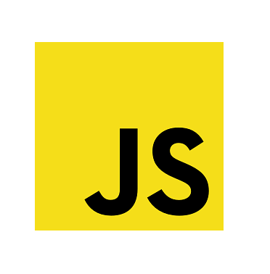
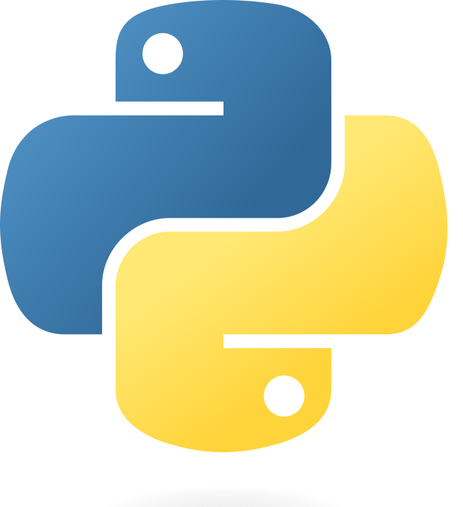

3. Types of ‘Programming Languages’ {
Languages
High-Level
Low-Level
Abstraction and Proximity to human language e.g. Python, Java
Direct Control over Hardware e.g. Assembly
Translated before execution
➡ Compiled:
➡ Interpreted:
Line-by-line execution
}
Programming Language

Slide 8
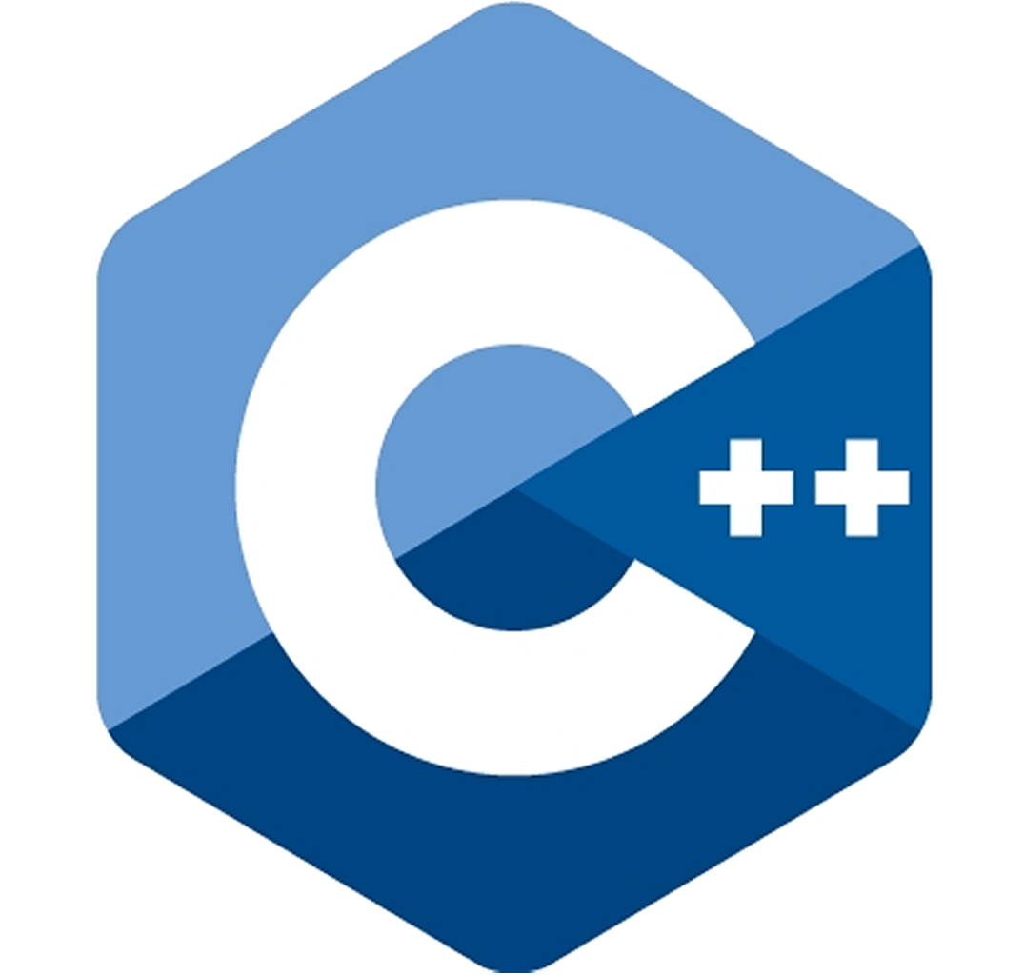
4. Types of ‘Programming Paradigms’ {
Languages
Procedural
Object-Oriented
Follows a step-by-step approach
Organization of code around objects
}
Programming Language

Slide 9
5. Programming Languages
Versatility, high-level, interpreted programming language known for its readability
General Purpose: Suitable for a wide range of applications.
Easy to Read and Write: Code readability and simplicity
Rich Ecosystem: Extensive libraries and frameworks
Year Created: 1991 Creator: Guido van Rossum Started the development of Python in 1980’s and officially released as Python 0.9.0 in February 1991
Applications: Web development, data science, AI, automation

Slide 10
5. Programming Languages
Versatile scripting language primarily used for web development
Web Development: Front-end(browser) and back-end (Node.js) scripting
Versatility: Supports asynchronous programming
Frameworks: Widely used with frameworks like React and Node.js
Year Created: 1995 Creator: Brendan Elch Allows developers to create dynamic and interactive web pages. It’s influence expanded with the rise of Node.js for server-side development
Applications: Building interactive and dynamic web applications

Slide 11
5. Programming Languages
General-purpose, OOP language designed for platform independence
Platform-Independence: Runs on any device with a Java Virtual Machine (JVM).
Enterprise Applications: Widely used for large-scale enterprise applications
Frameworks: Strong memory management and security features
Year Created: 1995 Creator: James Gosling and Mike Sheridan Java was released in 1995 and gained popularity for its “write once, run anywhere” philosophy. It has since become a cornerstone of enterprise software development and Android app development
Applications: Building interactive and dynamic web applications

Slide 12
5. Programming Languages
Extension of C programming language with added object-oriented programming features
Object-Oriented: Supports object-oriented design principles
System Programming: Used for low-level system development
Efficiency: Offers low-level memory manipulation
Year Created: 1979 Creator: Bjarne Stroustrup
Developed at Bell Labs in 1979, it was designed to enhance the C language with OOP features, making it suitable for both high-level and low-level programming
Applications: System Programming, game development

Slide 13
5. Programming Languages
A Dynamic, Object-oriented scripting language designed for simplicity and productivity.
Elegance: Elegant and concise syntax
Dynamic Typing: Flexibility in programming styles
Ruby on Rails: Powerful web development framework
Year Created: 1995 Creator: Yukihiro Matsumoto (“Matz”) Released in 1995, it gained popularity for its simplicity and elegance. The Ruby on Rails framework, introduced later, further boosted its prominence in web development
Applications: Web development, scripting

Slide 14
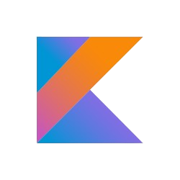
5. Programming Languages
Modern, statically-typed programming language designed to interoperate fully with Java and be fully supported by JetBrains.
Interoperability: Seamless integration with existing Java codebases
Conciseness: Reduces boilerplate code, enhancing developer productivity.
Null Safety: Built-in null safety features, reducing runtime errors.
Year Created:2011 Creator: JetBrains (led by Andre Breslav) Introduced Kotlin in 2011 as an alternative to Java for the JVM. It gained recognition as an official language for Android app development in 2017, contributing to its growing popularity.
Applications: Android app development, server-side applications, and modern web development

Slide 15
5. Programming Languages
Procedural programming language known for its efficiency, low-level memory access, and portability
Efficiency: Direct control over hardware resources for optimal performance Portability: Code in C can be compiled and run on various platforms
Foundational Language: Often used for building operating systems and embedded systems
Year Created: 1972 Creator: Dennis Ritchie Designed as a successor to the B language. Quickly became a foundational language for system programming, especially for the development of the Unix O.S. Applications: System Programming, Embedded Systems, Development of Operating Systems

Slide 16
6. Current Trends and Emerging Technology() {
1. Rust for System Programming
<Rust has ganed prominence for system programming due to its focus on safety without sacrificing performance>
2. TypeScript for Web Development
<A superset of JavaScript, is widely adopted for building scalable and maintainable web applications>
Integration with popular front-end frameworks like React and Angular further enhances its utility
};
Programming Language

Slide 17
6. Emerging Technologies and Frameworks() {
1. Machine Learning Libraries in Python
Python continues to dominate in machine learning with libraries like TensorFlow and PyTorch Emerging Technology: Increasing adoptiong of PyTorch for dynamic neural networks
2. Web Frameworks in JavaScript
JavaScript remains a key player with frameworks like React, Vue.js and Node.js, enabling the development of efficient and scalable web applications.
Emerging Technology: Rise of server-side rendering (SSR) and Next.js for enhanced web performance
};
Programming Language

Slide 18
7. Case Studies() {
Python
Developing a machine learning model for predictive maintenance in manufacturing
JavaScript
Building a scalable and real-time micro services architecture for a social media platform
Java
Developing a secure and robust backend system for a multinational banking institution
C++
Create an immersive and visually stunning virtual reality (VR) game.
}
Programming Language

Slide 19
8. Conclusion() {
1.
< Programming language choice is pivotal in achieving specific project goals.>
2.
< Each language excels in certain domains, and the success of a project often depends on selecting the right tool for the job>
3.
< Real-world case studies highlight the practical impact of programming language decisions on project outcomes>
};
Programming Language

Slide 20
THANK YOU 💻 () { Any Questions? };

Slide 21
9. References
Programming Language Documentations
- Python Documentation - JavaScript Documentation - C/C++ documentation - Ruby documentation - Java documentation
2. Web Development Frameworks
- React, Angular documentation
- Ruby on Rails documentation

